Slide 1
EDWARD
by Staying Alive

Slide 2
Our scope
THINK WIDER!
Instead of searching for what is good in Watson…
What can be improved in Watson

Slide 3
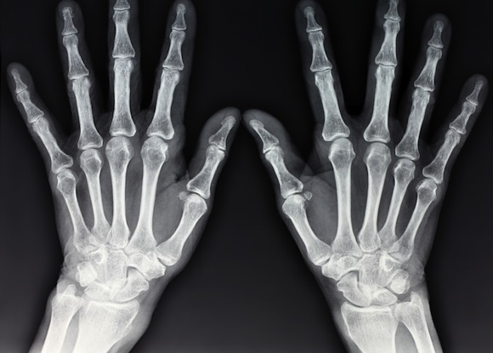
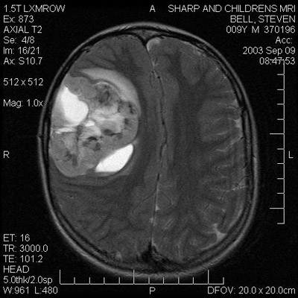
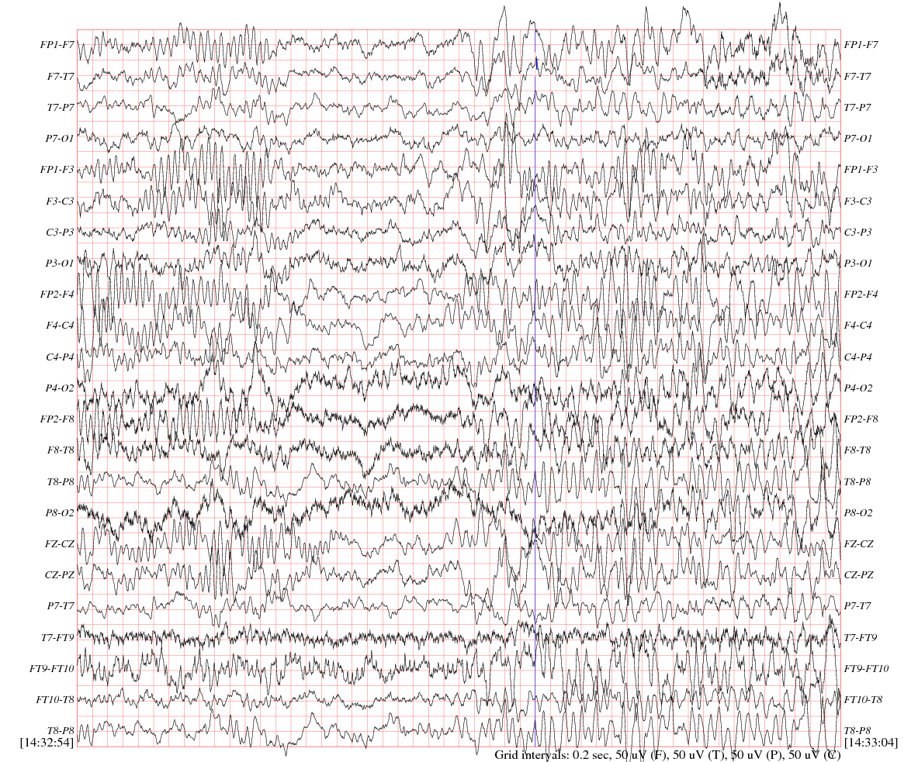
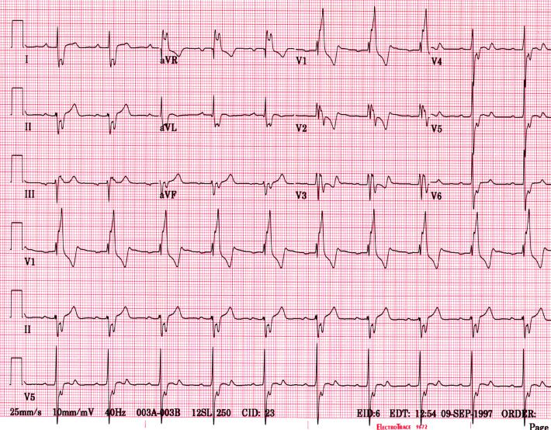
X-ray
MRI
EEG
EKG

Slide 4
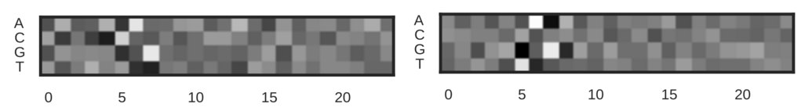
Even sequence analysis

Slide 5
Our solution
Instead of developing software based on Watson tool…
A NEW TOOL for IBM Watson
EDWARD – tool for creating customized Convolutional Neural Networks
By bioinformatics people, for bioinformatics people

Slide 6
